Slide 1

Introducción a R
07/10/2021

Slide 2
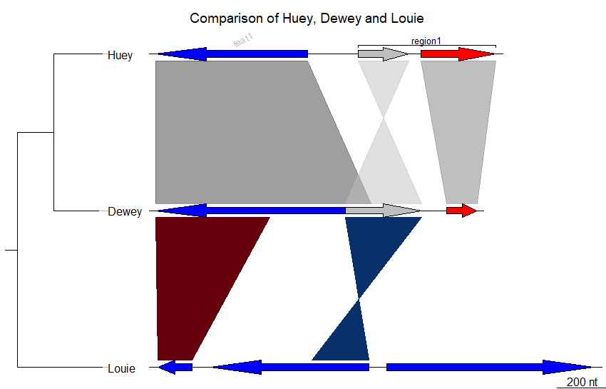
##
## Three genes
##
## Load library & data
library(genoPlotR)
data("three_genes")
## Saving data
## Uncomment the two commented lines if you wish to save the figures
## on your desktop
imgPath <- "../img"
pdfPath <- "../pdfs"
#imgPath <- "~/Desktop"
#pdfPath <- "~/Desktop"
## Color scheme
comparisons[[1]]$col <- apply_color_scheme(c(0.6, 0.4, 0.5), "grey")
## Tree
names <- c("Huey", "Dewey", "Louie")
names(dna_segs) <- names
tree <- newick2phylog("(((Huey:4.2,Dewey:3.9):3.1,Louie:7.3):1);")
## Annotations
mid_pos <- middle(dna_segs[[1]])
annot <- annotation(x1=c(mid_pos[1], dna_segs[[1]]$end[2]),
x2=c(NA, dna_segs[[1]]$end[3]),
text=c(dna_segs[[1]]$name[1], "region1"),
rot=c(30, 0), col=c("grey", "black"))
## Plots
png(file.path(imgPath, "three_genes.png"), h=150, w=500)
plot_gene_map(dna_segs=dna_segs, comparisons=comparisons,
annotations=annot, annotation_height=1.3,
tree=tree, tree_width=2,
main="Comparison of Huey, Dewey and Louie")
dev.off()
cairo_pdf(file.path(pdfPath, "three_genes.pdf"), h=2, w=4)
plot_gene_map(dna_segs=dna_segs, comparisons=comparisons,
annotations=annot, annotation_height=1.3,
tree=tree, tree_width=2,
main="Comparison of Huey, Dewey and Louie")
dev.off()
https://genoplotr.r-forge.r-project.org/screenshots.php

Slide 3
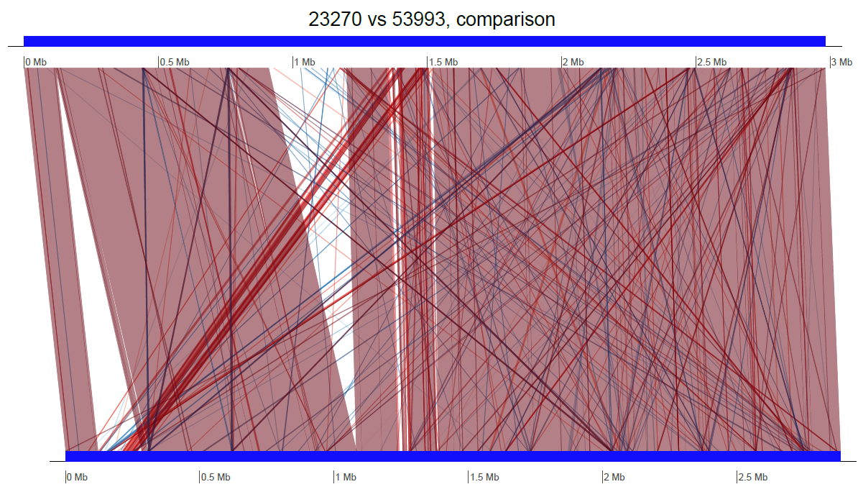
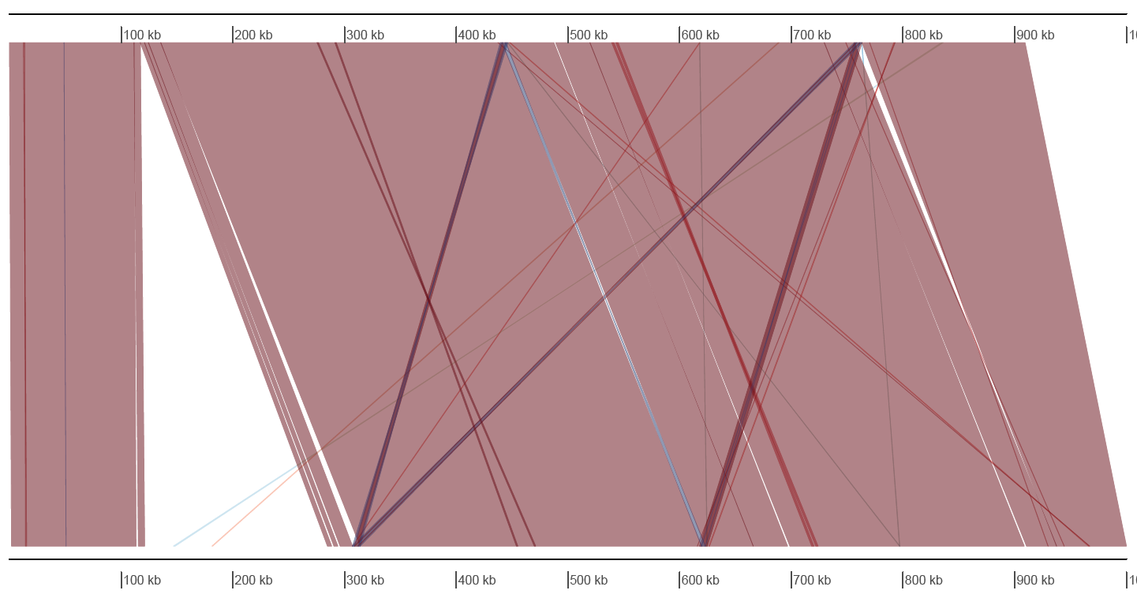
Synteny
blastn -query 2A_Acidithiobacillus_ferrooxidans_ATCC_23270.fna -subject 2A_Acidithiobacillus_ferrooxidans_ATCC_53993.fna -outfmt 6 -out 23270_53993.out
https://github.com/fissotta/R
Synteny

Slide 4
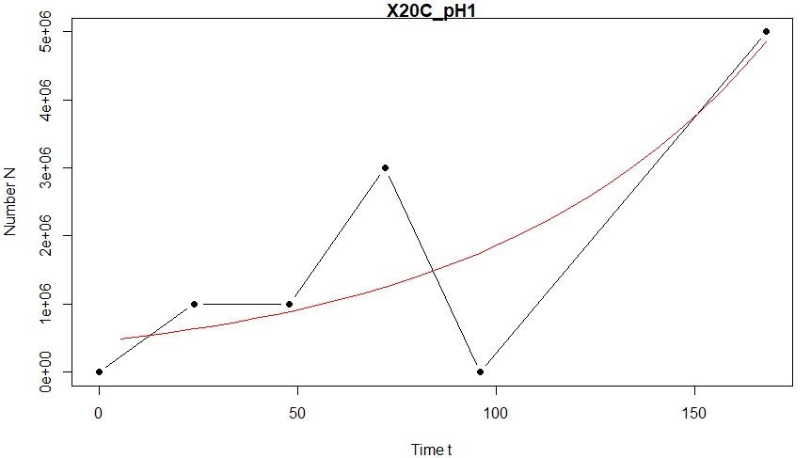
Growthcurver
Carrying capacity (k)
The maximum possible population size in a particular environment
Log initial population size (N0)
Growth rate (r)
Doubling time (DT)
also called the generation time, of a population is the time it takes for the number of individuals (or the absorbance reading) to double.
Area under the logistic curve (auc_l)
Empirical area under the curve (auc_e)
provides a metric (the logistic AUC) that integrates information from the logistic parameters (k, r, and N 0).
Fit data to K / (1 + ((K - N0) / N0) * exp(-r * t)):
K N0 r
val: 9833523047143.87 451326.384 0.014
Residual standard error: 1473391 on 3 degrees of freedom
Other useful metrics:
DT 1 / DT auc_l auc_e
49.07 2e-02 310950761.96 3e+08
https://github.com/fissotta/R
GROWTH

Slide 5

Recursos
https://bookdown.org/gboccardo/manual-ED-UCH/manejo-de-la-biblioteca-y-gestion-de-paquetes.html
https://ggplot2.tidyverse.org
https://genoplotr.r-forge.r-project.org/index.php
https://www.r-grap
https://cran.r-project.org/web/packages/growthcurver/vignettes/Growthcurver-vignette.htmlh-gallery.com/

